Slide 1

Working with

Slide 2
Agenda
What is AngularJS?
Main Concepts
Tools
Best Practices
Wrapping up

Slide 3
What is AngularJS?

Slide 4

“Angular is what HTML would have been had it been designed for applications.”
Miško Hevery

Slide 5
What is AngularJS?
Single Page Application (SPA) JavaScript Framework
Implements client-side MVW pattern
No direct DOM manipulation, less code
Well organized and highly modular
Focused on testing
Supports all major desktop and mobile browsers

Slide 6
History
What is angularjs?
Created by Miško Hevery
Open source since 2009
Supported by Google
Large and fast-growing community

Slide 7
Single Page Applications
What is angularjs?
Web applications composed of a single page
Views (HTML Fragments) are dynamically loaded into the page
Better user experience (no reloads!)
Calls to the server are done asynchronously behind the scenes
Require artificial handling of browser history, navigation and bookmarks

Slide 8
Model-View-Whatever
What is angularjs?
Some call it MVC, others MVVM...
In the end, the name does not matter. It handles separation of concerns efectively separating presentation logic from business logic and presentation state.
Whatever means “whatever works for you”.
Model
View
Whatever

Slide 9
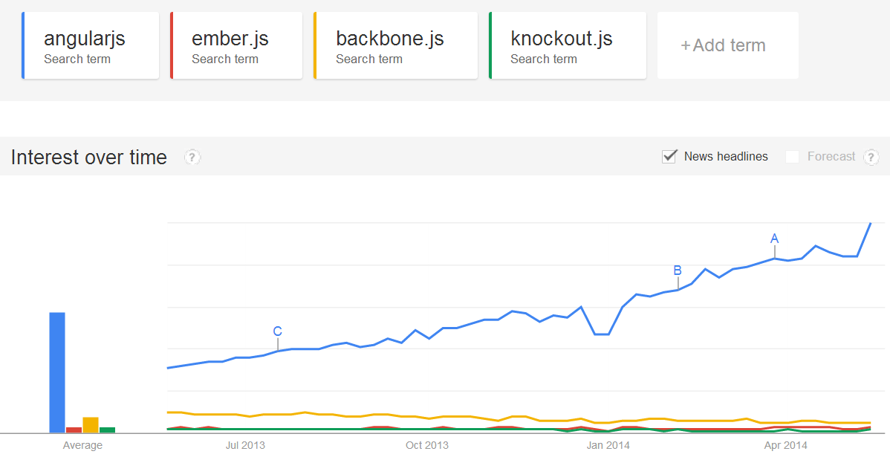
Trending topic
What is angularjs?
Source: Google Trends

Slide 10
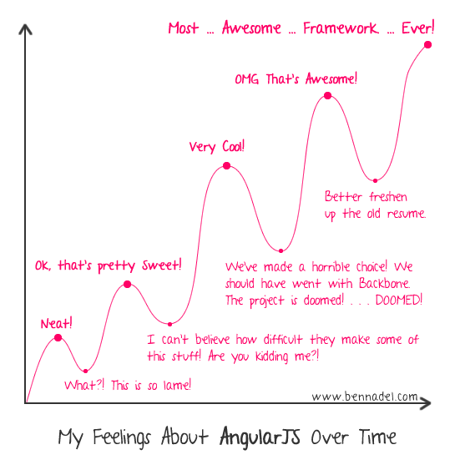
Learning curve
What is angularjs?

Slide 11
Main Concepts

Slide 12
Main concepts
Templates
Directives
Expressions
Data binding
Scope
Controllers
Modules
Filters
Services
Routing

Slide 13
Hello World
DEMO MAIN CONCEPTS

Slide 14
Hello world application
MAIN CONCEPTS
Directive
<!doctype html>
<html ng-app>
<head>
<title>Demo 01 - Page 03</title>
<script src="libs/angular.min.js"></script>
</head>
<body>
<p>Name:<input id="textInput" type="text" ng-model="PersonName" /></p>
<p>Hello <span id="nameSpan">{{PersonName}}</span>!</p>
</body>
</html>
Template
Directive
Expression

Slide 15
Templates
Main concepts
HTML with additional markup
Directives
Expressions
Filters
Form controls
Read More: https://docs.angularjs.org/guide/templates

Slide 16
Directives
Main concepts
Markers on DOM elements that extend HTML vocabulary
Attach behaviour to the DOM element
Transform the DOM element and its children
Directives can match:
Elements <my-dir></my-dir>
Attributes <span my-dir="exp"></span>
Comments <!-- directive: my-dir exp -->
Classes <span class="my-dir: exp;"></span>
Read More: https://docs.angularjs.org/guide/directive

Slide 17
Naming formats
Main concepts / directives
AngularJS HTML compiler supports multiple naming formats
ng-bind Recommended format.
data-ng-bind Recommended format to support HTML validators.
ng_bind Legacy purposes. Avoid using it.
ng:bind Legacy purposes. Avoid using it.
x-ng-bind Legacy purposes. Avoid using it.
Read More: https://docs.angularjs.org/guide/directive

Slide 18
Built-in directives
Main concepts / directives
ngApp ngBind ngBindHtml ngBindTemplate ngBlur ngChange ngChecked ngClass ngClassEven ngClassOdd ngClick ngCloak ngController ngCopy ngCsp ngCut ngDblClick ngDisabled ngFocus ngForm ngHide ngHref ngIf ngInclude ngInit ngKeydown ngKeypress ngKeyup ngList ngModel ngModelOptions ngMousedown ngMouseenter ngMouseleave ngMousemove ngMouseover ngNonBindable ngOpen ngPaste ngPluralize ngReadonly ngRepeat ngSelected ngShow ngSrc ngSrcset ngStyle ngSubmit ngTransclude ngValue ngView
Read More: https://docs.angularjs.org/guide/directive

Slide 19
Expressions
Main concepts
JavaScript-like code snippets placed inside bindings such as
{{ expression }}
Valid Angular expressions:
{{ 1 + 2 }}
{{ a + b }}
{{ user.name }}
{{ items[index] }}
Additional notes about expressions:
Control flow statements are not supported (conditionals, loops or exceptions)
You can use filters inside expressions to format data
Read More: https://docs.angularjs.org/guide/expression

Slide 20
Expressions
DEMO MAIN CONCEPTS

Slide 21
Data binding
Main concepts
Automatic synchronization of data between the Model and the View.
One-Way Data Binding
Two-Way Data Binding
View
Template
Compile
One-time merge
View
Template
Model
Changes to View updates Model
Continuous updates
Model is Single-Source-of-Truth
Changes to Model updates View
Model
Read More: https://docs.angularjs.org/guide/databinding

Slide 22
Two-way data binding
DEMO MAIN CONCEPTS

Slide 23
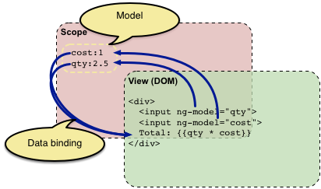
Scope
Main concepts
Object that refers to the application Model
Values stored in variables in the Scope belong to the Model
The glue between the Controller and the View
Scopes are hierarchical and follow the DOM structure of the application
Every Angular application has a root scope ($rootScope) mapped to the element linked to ngApp directive
Read More: https://docs.angularjs.org/guide/scope

Slide 24
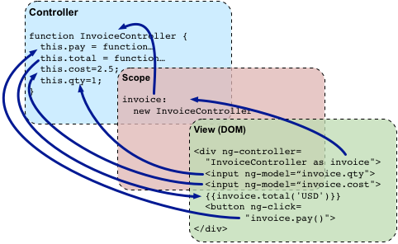
Controllers
Main concepts
JavaScript constructor functions used to augment the Scope
New child scope is created and injected as a constructor parameter ($scope)
Read More: https://docs.angularjs.org/guide/controller

Slide 25
How to use controllers
Main concepts / controllers
Creating a controller in the global namespace
function MyController($scope) {
...
}
Attaching a controller to the DOM
<div ng-controller="MyController">
Read More: https://docs.angularjs.org/guide/controller

Slide 26
When to use controllers
Main concepts / controllers
Use controllers to:
Set up the initial state of the $scope object
Add behaviour to the $scope object
Do not use controllers to:
Manipulate DOM (use databinding and directives instead)
Format input (use form controls instead)
Filter output (use filters instead)
Share code or state across controllers (use services instead)
Read More: https://docs.angularjs.org/guide/controller

Slide 27
Using controllers
DEMO MAIN CONCEPTS

Slide 28
Module
Main concepts
Reusable container for different features of an app.
Can depend on other modules.
Creating a module
angular.module('myApp', []);
angular.module('myApp', ['myOtherModule']);
Referencing an app’s main module
<html ng-app="myApp">
Read More: https://docs.angularjs.org/guide/module

Slide 29
Using modules
DEMO MAIN CONCEPTS

Slide 30
Filters
Main concepts
A filter formats the value of an expression for display to the user
Can be used in view templates, controllers, services and directives
You can create your own filters (in a module)
Built-in filters:
Currency
Date
Filter
Json
LimitTo
Lowercase
Number
OrderBy
Uppercase
Read More: https://docs.angularjs.org/guide/filter

Slide 31
Using filters in view templates
Main concepts / filters
Single filter syntax
{{ expression | filter }}
Example: {{ 12 | currency }} returns $12.00
Chained filters syntax
{{ expression | filter1 | filter2 | ... }}
Filter with arguments
{{ expression | filter:argument1:argument2... }}
Example: {{ 12 | number:2 }} returns 12.00
Read More: https://docs.angularjs.org/guide/filter

Slide 32
Using filters in controllers, services and directives
Main concepts / filters
angular.module('FilterInControllerModule', []).
controller('FilterController', ['filterFilter', function(filterFilter) {
this.array = [
{name: 'Tobias'},
{name: 'Jeff'},
{name: 'Brian'},
{name: 'Igor'},
{name: 'James'},
{name: 'Brad'}
];
this.filteredArray = filterFilter(this.array, 'a');
}]);
Inject filter in controller using <filter name>Filter syntax
Receive filter function as a parameter
Call filter with value to format and additional parameters
Read More: https://docs.angularjs.org/guide/filter

Slide 33
Creating filters
Main concepts / filters
Name the filter
angular.module('MyFilterModule', []).
filter('myfilter', function() {
return function(input) {
...
return output;
};
});
User the filter provider to create a new filter in the module
Return the filter function. The first argument is the input value. Additional arguments can be used.
Read More: https://docs.angularjs.org/guide/filter

Slide 34
Using filters
DEMO MAIN CONCEPTS

Slide 35
Services
Main concepts
Reusable business logic componentes, independent of views, wired together using dependency injection (DI).
Singletons generated by a service factory.
Angular only instantiates a service if there is a dependency for it.
Built-in services start with $. Examples: $log, $http, $filter, $exceptionHandler
Read More: https://docs.angularjs.org/guide/services

Slide 36
Using a service
Main concepts / Services
Inject $http service using DI
var countryApp = angular.module('countryApp', []);
countryApp.controller('CountryCtrl', ['$scope', '$http', function (scope, http) {
http.get(‘countries.json').success(function(data) {
scope.countries = data;
});
}]);
Receive service object as a parameter
Call method on service
Read More: https://docs.angularjs.org/guide/services

Slide 37
Creating a service
Main concepts / Services
Register a new factory function for the service
var myModule = angular.module('myModule', []);
myModule.factory('serviceId', function() {
var shinyNewServiceInstance;
//factory function body that constructs shinyNewServiceInstance
return shinyNewServiceInstance;
});
Return a service instance
Read More: https://docs.angularjs.org/guide/services

Slide 38
Recipes
Main concepts / SERVICES
var myApp = angular.module('myApp',[]);
myApp.provider('MyFactory', function() {...});
myApp.factory('MyFactory', function() {...});
myApp.service('MyFactory', function() {...});
myApp.constant('MyConstant', 'My Constant Value');
myApp.value('MyValue', 35);

Slide 39
Using services
DEMO MAIN CONCEPTS

Slide 40
Multiple views
Main concepts
Most applications are composed of more than one view
In Single Page Applications all views are rendered in the same page (Layout Template) which contains all the common page elements
Each view (Partial Template) is placed in its own file and dynamically loaded into the Layout Template page

Slide 41
Multiple views
Main concepts
Partial Template
Partial Template
Layout Template
b1.html
a2.html
index.html
header.html
a1.html
b2.html
a3.html
b3.html
Partial Template
Partial Template

Slide 42
Routing
Main concepts
Routing is provided by the ngRoute module (separate distribution)
Routes are declared via the $routeProvider from the $route service
Supports deep linking (history, bookmarks and browser back/forward buttons)
Partial views are rendered by the ngView directive

Slide 43
Routing configuration
Main concepts / routing
var myApp = angular.module('myApp',['ngRoute']);
myApp.config(['$routeProvider',
function($routeProvider) {
$routeProvider.
when('/phones', {
templateUrl: 'partials/phone-list.html',
controller: 'PhoneListCtrl‘
}).
when('/phones/:phoneId', {
templateUrl: 'partials/phone-detail.html',
controller: 'PhoneDetailCtrl'
}).
otherwise({
redirectTo: '/phones'
});
}]);
Dependency on ngRoute module
Route
Route with variable URL. PhoneId value will be placed in $routeParams object
Default Route

Slide 44
Routing
DEMO MAIN CONCEPTS

Slide 45
Best practices

Slide 46
Best Practices
In Views/Templates
Use directives for abstracting common markups, extensions
Do not use complex expressions in bindings. Move them to controllers.
Optimize use of bindings. Less bindings = faster application.
In Controllers
Keep them light. Use services to offload functionality.
No DOM manipulations! Use directives for that.

Slide 47
Best Practices
In Directives
Prefer using directives as elements or attributes over classes and comments
Do not ng- prefix for your directives
Create isolate scopes to avoid acidental overrides of properties
Create modules to group controllers, services, directives and filters

Slide 48
Tools

Slide 49
Tools
IDE: Visual Studio, NetBeans, WebStorm
Utils: JSFiddle, Batarang Plugin for Chrome
Static Code Analysis: JSHint
Unit Testing: Karma

Slide 50
Wrapping up

Slide 51
Wrapping up
AngularJS is a modular JavaScript SPA framework
Has a lot of great features but a steep learning curve
Great for CRUD applications but not suitable for every type of application
Works very well with some JavaScript libraries (such as jQuery) but not so well with others
Increases developer productivity in small/medium applications but can be quite heavy for complex applications

Slide 52
Next time...
Wrapping up
Custom directives
Form controls and validation
Unit testing
End-to-end testing
Animations

Slide 53
Resources
Wrapping up
Official documentation
Project homepage: https://angularjs.org/
Developer Guide: https://docs.angularjs.org/guide
Tutorial: https://docs.angularjs.org/tutorial
API Reference: https://docs.angularjs.org/api
Built with Angular: https://builtwith.angularjs.org
Additional stuff
Angular modules: http://ngmodules.org/

Slide 54
Thank You!
Download slide deck: http://1drv.ms/1h1YOlS
Download demos: http://1drv.ms/1h1YJyP

